Slide 2
Chapter 1: Introduction
Part A: Core Concepts
Part B: The Practicalities
Rationale, Scope and Background of Cultural Risk Assessment and CIERA
Chapter 2:
Chapter 8:
Cultural Risk Assessment & The Cultural Inclusivity and Equity Risk Assessment (CIERA)
Chapter 3: Cultural Risk – EEDI and Bias
Activating Theory -
England and Wales Cricket Board
Chapter 9:
Chapter 4: The Science of Inclusion and Bias
Managing Organisational Risk: Integrating Cultural Risk Awareness into Corporate Governance
Chapter 10:
Chapter 5: Culture
Chapter 11:
Comparing faith in cultural contexts: In Sacred Spaces and on the Dancefloor
Chapter 6: Theories and Frameworks
Chapter 12:
Activating Theory - Action Research with Faith Leaders for the British Ritual Innovation in COVID
Chapter 7: Cultural Intelligence (CQ)
Chapter 13:
Between the lines -
Conversations in Context, a Dialogical Approach
Part C: Case Studies
CS 1: Sweden – Religious Heritage
CS 10: UK – Faith and Sexuality
CS 2: UK – Sensory Rooms
CS 6: Qatar – Football World Cup
CS 11: UK – Cultural Events
CS 3: England – Prom Events
CS 7: USA – NFL
CS 12: USA – Belonging and Ethnicity
CS 4: UAE – Cultural Awareness
CS 8: Japan – Cultural Heritage
CS 13: Caribbean – Diaspora Communities
CS 5: Australia – Indigenous Communities
CS 9: UK – Sport and Gender
CS 14: Nigeria – Business Events

Slide 3
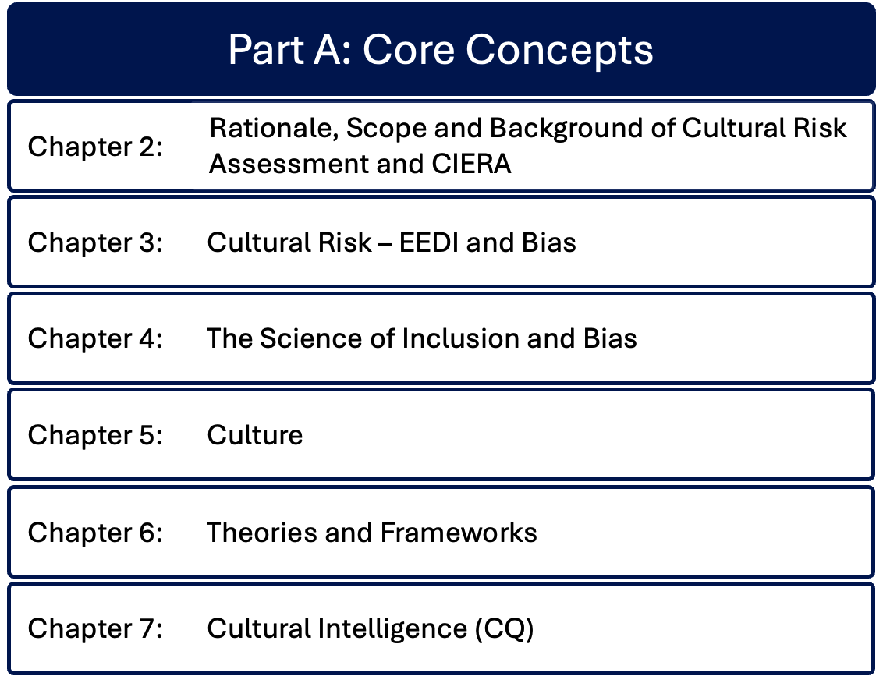

Slide 4
Chapter 5: Culture
Bernadette Albert
Explores definitions of culture, its components and complexities, reviewing key theories from sociological and historical perspectives.
Discusses the criticality of cultural identity where norms, values, beliefs support individuals navigating and becoming embedded in the social structure, providing opportunities for social cohesion.
Considers the impacts of globalisation, cultural diffusion and acculturation on culture, where cultures interact and blend, forming hybrids.
Acknowledges criticality of cultural resilience in preserving and protecting cultural heritage amidst external pressures to adapt, change or be lost.
Underscores the enduring and evolving nature of culture in a connected and globalised world.

Slide 5
Defining Culture and its components
‘The way of life of a people’
Interplay between different contexts, communities and spaces
Shared meanings, beliefs, understandings – collective
Looking beyond ‘what does it mean to me?’ To ‘what does it mean to us?’
Not all culture is consciously known

Slide 6
Cultural identity and social cohesion
Becoming part of social structure and understanding of self
National and ethnic elements – internalised and externalised – builds shared identity, sense of belonging
Challenges of multicultural and super-diverse environments including events
Event management requires deeper understanding of culture and cultures

Slide 7
Cultural norms and social behaviour
Creating inclusive spaces requires understanding of diverse cultural norms and social behaviours, especially of groups
Cultural norms may be invisible to those outside the culture
Schemata – elements of cognitive information: procedural (automatic skills, knowledge); declarative (facts, what we know); evaluative (orients choice and impacts action); cultural knowledge
Norms – shared evaluations e.g. queueing in the UK
Diverting to individual cultural norms and values can result in cross-cultural conflict in diverse event contexts

Slide 8
Globalisation and cultural change
Rapid exchange of goods, technology, people has influenced social norms, traditions, language
Dominant cultures spread through media – erodes local traditions
MacDonaldisation – automation, convenience
Acculturation – loss of cultural identity
Cultural hybridity – blending to form new identities

Slide 9
Cultural diffusion
Process by which cultural elements – language, beliefs, practices, values, artefacts, technologies – spread between social groups
Caused by migration, war, colonisation, trade (e.g. adopting non-indigenous food, clothing, music)
Diffusion types: expansion; contagious; hierarchical; stimulus; relocation
Diffusion can be direct or indirect

Slide 10
Acculturation
Cultural identities evolve and adapt to navigate spaces and societies
Can lead to cultural hybridity, adaptation, assimilation – and more complexity
Event managers need to be aware of the potential for cultural sustainability, appropriation and dilution of indigenous cultural practices and events
Ethical cultural representation – ensuing cultures are represented accurately and respectfully

Slide 11
Cultural resilience
Cultural heritage challenged by dominant powers suppressing and erasing indigenous / minority cultures – colonialism, forced assimilation, globalisation
Cultural resilience – cultural processes and systems in communities that enable them to preserve and sustain existing culture and collective identity
Events provide opportunities to revitalise cultures and enhance cross-cultural dialogue
Requires cultural respect, sensitivity, authenticity

Slide 12
Summary
Dynamic and multifaceted nature of culture
Shred practices, beliefs, traditions, values shape collective and individual identities
Cultural change is inevitable
Event managers require appreciation of cultural complexity

Slide 13
Discussion Questions
As you read this chapter, what are three ideas that seem most important to you as an event manager?
Write a short list of actions that you can take to learn more about cultural norms, cultural diffusion and acculturation.
What ideas do this chapter give you for developing your own cultural intelligence (CQ)?
Give four reasons why cultural resilience is important.
After reading this chapter, how would you define ‘culture’?

